Slide 1
ADAPTATION
iranGrain 2024
Oct 1 and 2, Tehran
Impact of Climate Change on Global Grain Production
Sharif Nezam Mafi

Slide 2
1992 Earth Summit
UN Framework Convention on Climate Change (UNFCCC) was signed
The only industry UN singled out that will require Adaptation was Agriculture
That year the planet produced 1.95bn tonnes of wheat, rice, corn (maize) and other cereals.
This provided half of worlds dietary calories

Slide 3
Year 2024
Fossil Fuels emissions were over 50% higher.
World cereal production has grown
Reaching 3bn tonnes
Outstripping population and emissions growth

Slide 4
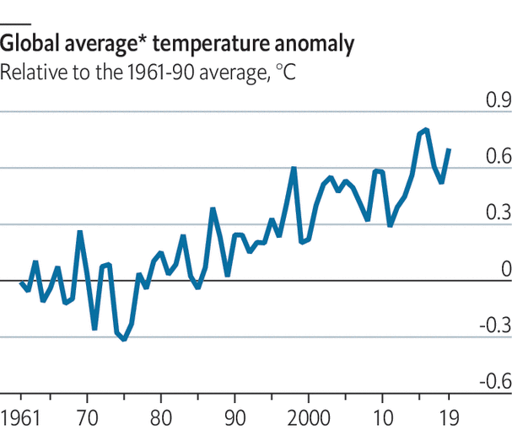
Half of all emissions since the industrial revolution took place in the past 28 years
Mainly due to the growth of China and US

Slide 5
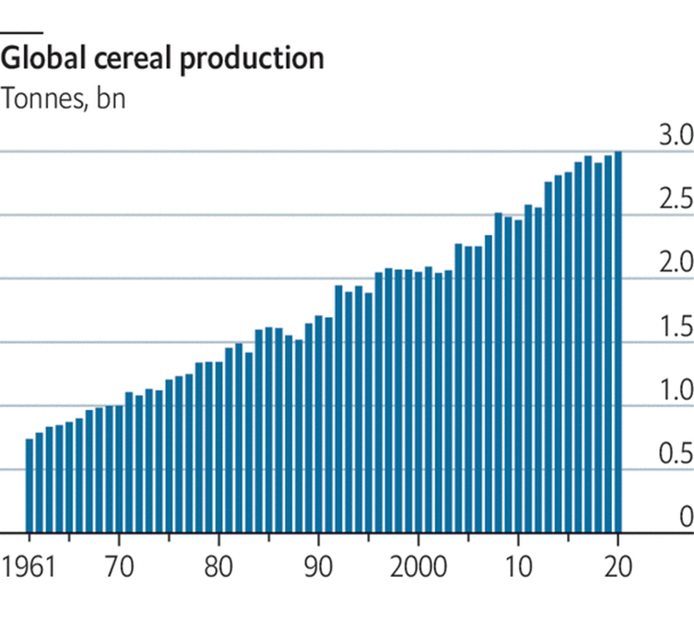
Agro growth was achieved without massive increases in the areas being farmed

Slide 6
why
Plants grow better in air richer with carbon dioxide
Plants enjoy longer season
More efficient farming methods
New heat resistance stains
More grain production per person in 2024 than in 1992

Slide 7
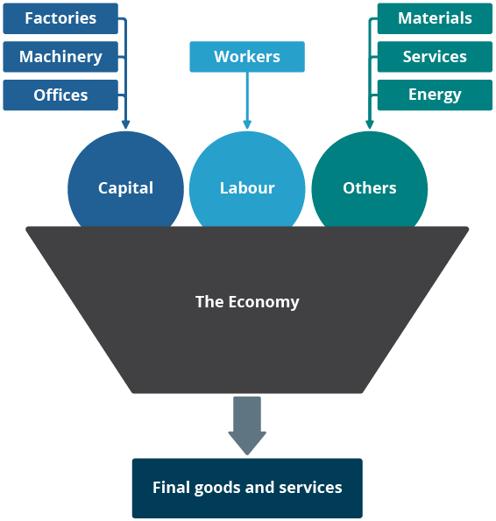
TFP
Total-Factor Productivity
All costs of labor, land and other inputs has more than doubled worldwide since beginning of 1960
Higher yielding strains
Sensors that monitor water and nutrients in the soil
Satellite navigation systems

Slide 8
AgTech
New Industry in itself is born
Water
Fertilization
New products and sensors that help plants of all types survive with less water
Substances that simulate plants to fertilizes themselves, by harnessing the nitrogen fixing properties of certain bacteria.
Manipulate plants biochemical messengers to induce them to grow faster and produce more

Slide 9
Susa, Iran
Case Study
Mean Temperature
Effects
Susa is 2.5 degree Celsius higher than 1980
July 2024, new record high was 53.9
More water usage from Dez and rivers (Sahour, Dez and Karoun)
Seed variety are not heat friendly, reducing yield
Summer farming is becoming water well centric
Summer farming time has become shorter or harvested later, thus impacting plantation of fall harvest

Slide 10
Opportunity Cost
Total Factor Productivity
TFP Lost
Losses due to climate Change increasing
TFP has been 40% smaller in agricultural sector than could have been over the same period in absence of climate change
Population still growing
Food needed are changing in nature (more meat for developing countries)

Slide 11
National Adaptation Plan
Aim to identify people, infrastructure and industries most vulnerable
Four fifth of developing countries have began such work
From 2019-2020 roughly $46bn a year was invested in adaptation globally
This 50% less than what is needed according to UNEP
It is estimated that the level of adaptation spending needed in developing countries between $140bn to $300bn.

Slide 12
High Yield Investment
Solution to adaptation is Agtech
80% of Iranian Farmland have no irrigation
Agtech solutions
Farmers to be given drought resistant seeds, access to weather forcast, education in no-till farming
Pest resistance
Salt resistance
Flood resistant
Massively improve yield.
Nor do farmers have information about the changes excepted due to climate change in the years ahead

Slide 13
Adaptation is Needed
Iran shells out billions a year to provide farmers cheap fertilizers, energy and old seeds among other things

Slide 14
THANK YOU!
iranGrain 2024

